Slide 1

Unicorn Companies PYTHON FOR DATA ANALYTICS PROJECT 2023
Exploratory Data Analysis of Unicorn Companies Around the World
By Christina Relebogile Sekete

Slide 2
Contents
Summary of Unicorn Enterprises
Focusing on the Accumulation of Unicorn Expansion
Trends in Unicorn Investments And Growth
▪Growth Recommendations For Unicorns

Slide 3
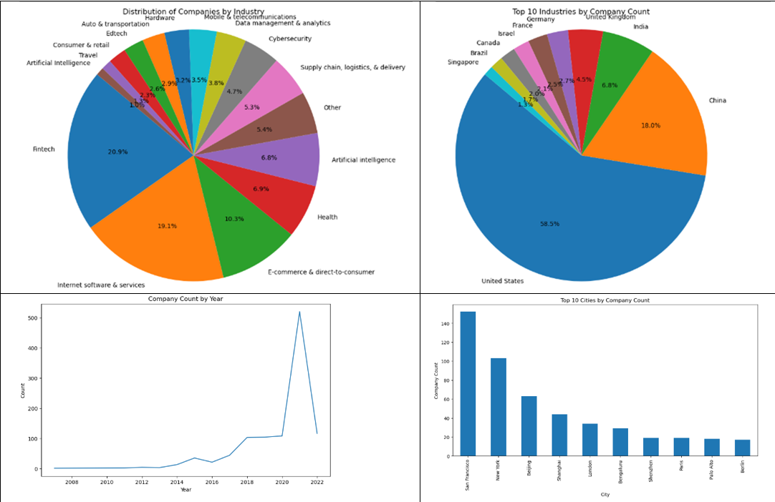
Summary of Unicorn Enterprises
Looking at the chart on the left we can see that the is a distribution of companies by industry ,where we have categories like e-commerce and direct to consumer is one of the main players by 10.3% and the largest category is fintech by 20.9% .the range is from 20.9% to 1% which is the category artificial intelligence can also notice on the chart that isa far left that more companies are based in the united states by 58.5% and the least at 1.3% in Singapore .the company count has grown over the years in a leaner manner and sky rocketed in the 2020 to 2021 because of the covid ,industries like fintech, internet software and service and e-commerce and direct service grew because everyone was now becoming digital to avoid being sick. the top cities are from countries like united states(San Francisco) and China (Beijing)

Slide 4
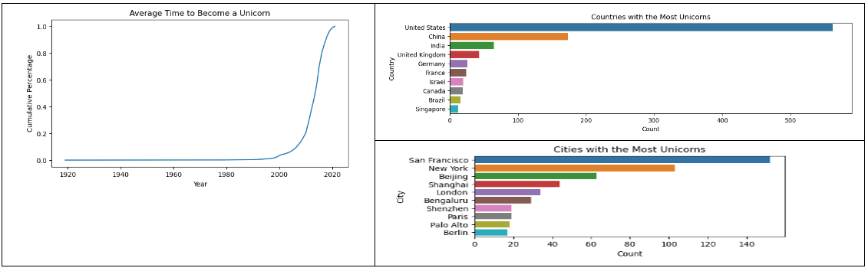
Focusing on the Accumulation of Unicorn Expansion
Time to Become a Unicorn, On average, businesses reach unicorn status a few years after being established. But as time has gone on, it has taken less time to become a unicorn, indicating a tendency toward rapid growth. The United States and China are the two nations having the most unicorn enterprises, respectively. These nations are hubs for the expansion of unicorns and creative enterprises. Cities that are industry centres include Beijing and Shanghai in China.

Slide 5
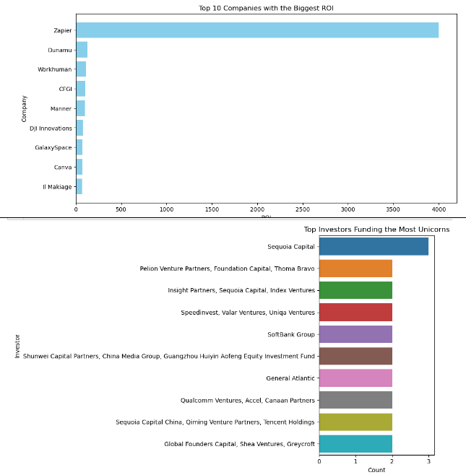
Trends in Unicorn Investments And Growth
Top unicorn investor, investors with a significant presence in the startup ecosystem include sequoia capital, sequoia capital China, and accel partners, all of whom have invested many unicorn businesses.
largest return on investment (Roi) companies: the largest return on investment (Roi) has been attained by otto bock healthcare, Zapier, and dunamu. with a roi of 4000.0, Zapier stands out and indicates extraordinary progress.

Slide 6
Growth Recommendations For Unicorns
Investment Portfolio Diversification: Unicorn firms should think about diversifying their investment portfolio by looking into opportunities in different areas. Diversification may lower risks while keeping an eye on sectors with strong development potential, such as health and FinTech. Accelerate Growth: Unicorn enterprises should concentrate on tactics to quicken their growth to keep up with the trend of faster attainment of unicorn status. Increased finance, clever alliances, and effective scaling could all fall under this category. Global development: Businesses should emphasize global development while concentrating on these important markets, especially considering the US and China's dominance in the unicorn environment. Strategic advantages may result from establishing a presence in economic centres like Beijing and Shanghai. Relationships with major Unicorn Investors: Businesses should establish solid connections with major unicorn investors like Sequoia Capital.
Collaboration with these investors and alignment with their interests can improve access to funding and growth possibilities. In general, unicorn companies should use data-driven insights to make wise decisions, give high-growth potential the highest priority, and keep their agility in a fast-paced business environment. Due to this, they will be able to develop profitable business models and maintain their amazing growth trajectories.

Slide 7

Thank you

